Slide 1
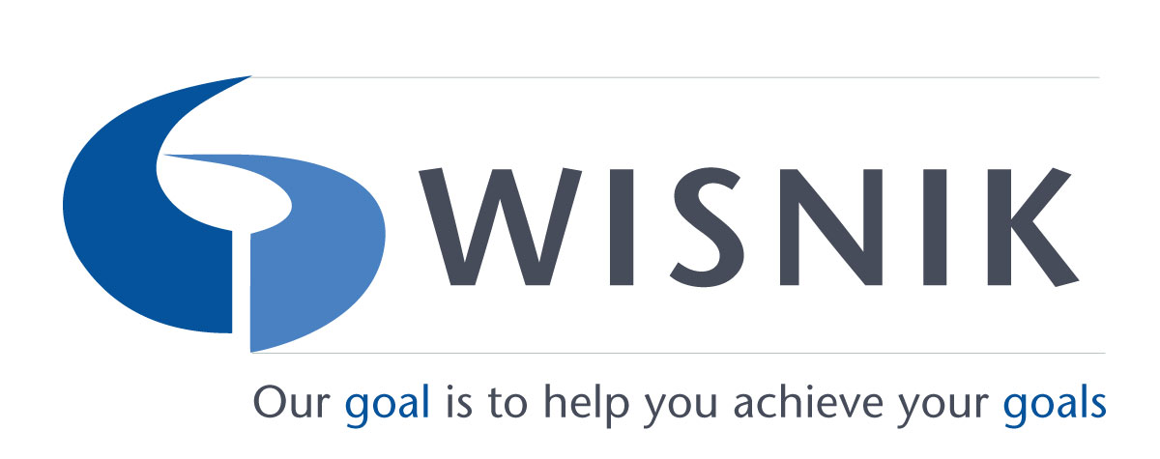
7 Pillars for
Interview Mastery
During this workshop, participants will:
In this 60-minute customized training, your attorneys will learn the 7 Pillars for Strategic Hiring so they can identify the most important traits in target candidates, ask the right behaviorally-based interview questions, and provide clear selling messages that leave a lasting positive impression.
By investing in this skills-based interviewer training, your attorneys will have the tools to ask high-mileage questions and the know-how to provide meaningful feedback to ensure that you hire the right legal talent and leave a lasting positive impression on candidates.
Each attendee will receive a workbook with sample questions to help them prepare for interviews.
Learn to interview intentionally by being clear about what traits to look for in future hires
Understand the importance of asking behaviorally-based questions
Learn how to prepare purposefully to create a meaningful interview experience
Master key selling messages, so every candidate knows what distinguishes your firm
Gain insights for avoiding unconscious bias during the interview process
Since founding her business in 1996, Eva Wisnik has conducted training programs for more than 120 firms nationwide.
Wisnik Career Enterprises, Inc
www.Wisnik.com
ewisnik@wisnik.com
Notes:
Decide on font for boxes

